Slide 1
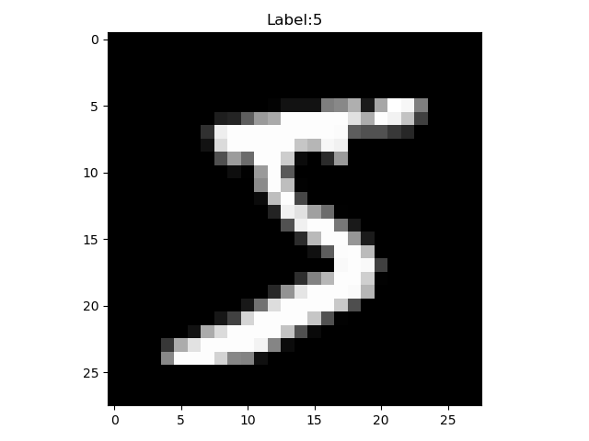
Assignment 2: MNIST classification
[Objective]
Your model should classifiy of the images into 10 classes (0~9).
[Requirements]
1. Implement 4-layer perceptron with Pytorch or Tensorflow.
(Basic code is provided)
2. You should experiment with settings stated in the evaluation report, and report the result of each settings.
3. You should attach the plot of the validation dataset accuracy plot.
4. You should report the experimental results.
(all kinds of additional experiments are recommended)
model
"5!"

Slide 2
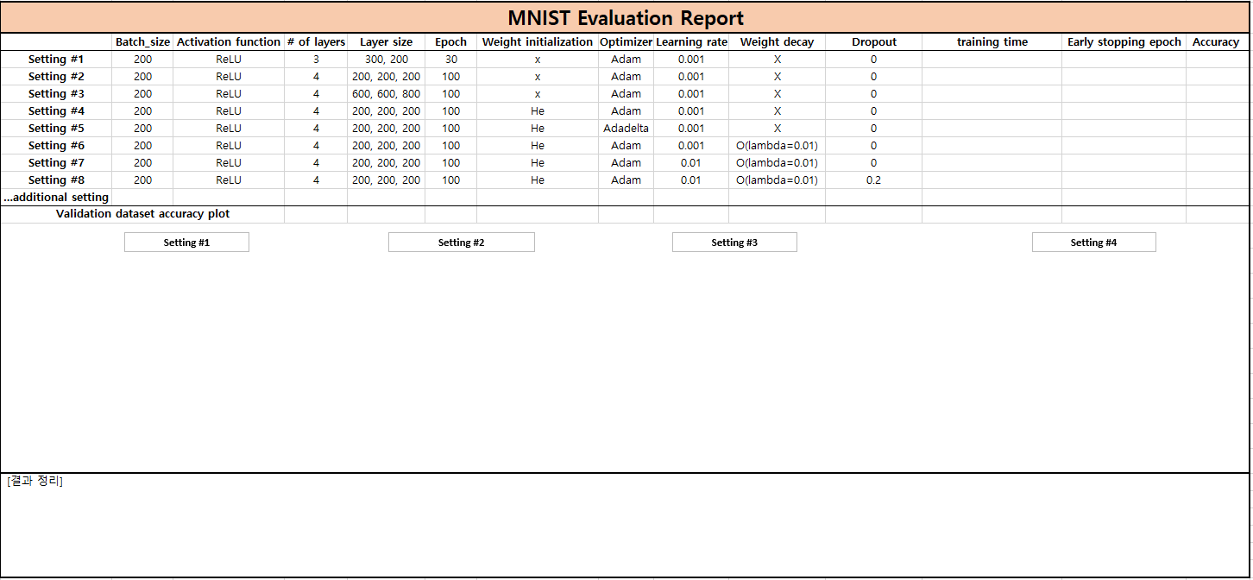
Assignment 2: MNIST classification
[Evaluation report]

Slide 3
Assignment 2: MNIST classification
Evaluation Criteria
Simplicity | How concisely did you write the code? - 배점 6점 4 Layers: 4점 Weight initializer: 1점 Dropout: 1점 Weight decay: 1점
Performance | How well did the results of the code perform? - 배점 2점 - acc 97.5%이상 달성 시 만점
Brevity and Clarity | How concisely and clearly did you explain the results? - 배점 2점

Slide 4
Assignment 2: MNIST classification
- Due to : ~ 9.20(Sun)
- Submission : Online submission on blackboard
- Your submission should contain
1) The whole code of your implementation
2) The evaluation report
- You must implement the components yourself!
- File name : StudentID_Name.zip

